Slide 1

Midterm meeting
Road Grade-Aware Energy Consumption Modeling for EVs
○○ University of California, Berkeley,
○○ Mechanical Engineering,
Prof. Francesco Borrelli ○○○
August 2025

Slide 2
◆ List of researchers
Classification | Department | Name | Position | Email | Role
Research director | Dept. of Mechanical Engineering, UC Berkeley | Francesco Borrelli | Professor | fborrelli@berkeley.edu | Research Director, Head of MPC lab at UC Berkeley
Main researcher | Dept. of Mechanical Engineering, UC Berkeley | Mark Pustilnik | PhD Candidate | pkmark@berkeley.edu | PhD Student at the MPC lab
Researchers | Dept. of Mechanical Engineering, UC Berkeley | Yongkeun Choi | Post Doc. | yk90@berkeley.edu | Past Post Doc at the lab. Initiated the project

Slide 3
Contents
Background of the research | 4
Research goal and expected effect | 5
Research progress | 6
Research contents
1. Data Samples | 7
2. Data Filter and Normalization | 8
3. Data Analysis | 9-10
Midterm research results | 11
Future research plan | 12

Slide 4
Background of the research
Motivation:
EV range prediction is critical for adoption and user confidence (fight range anxiety).
Current models lack accuracy on hilly roads.
Problem Statement
Road grade has a significant impact on energy consumption
Most models are generic, not vehicle-specific
Identify the main parameters affecting the energy consumption of EV on sloped roads
Necessity
Develop and validate a physics/empirical model tailored for real vehicles on real roads
Incorporate an grade aware energy model in a car path planner

Slide 5
Research goal and expected effect
Research goal | Collect real world data of energy consumption, road grade and other relevant parameters Analyze and identify the main parameters that affect the energy consumption on roads with different grades Build and validate a road grade–aware energy model for electric vehicles
Expected effect | Improve the accuracy of trajectory planning with grade aware models lower the probability of energy distress of an EV due to higher than expected road grades

Slide 6
Research progress
Original plan
Current status
Item | Details | 1 | 2 | 3 | 4 | 5 | 6 | 7 | 8 | 9 | 10 | 11 | 12 | Remark
Basic study | Review MOST spec
 | Review equipment manual
Test bed establishment | Test new equipment
 | Develop MOST emulator
 | Develop emulator head and client
 | Integrated test and debugging
 | Develop test results analysis tool
Topology basic research | Literature investigation
Monitoring tool development | Develop program
 | Interlocking test and debugging
Final report | Wrap-up and submit a final report
▲ 1st technical meeting (Apr/2)
Delayed delivery of MOST equipment, purchase of related equipment
Equipment test delayed, malfunction of OASIS equipment
▲ 2nd technical meeting (Jul/15)
Delayed emulator development
Delayed equipment test
Delayed program development
▲ Interim meeting (Oct/30)

Slide 7
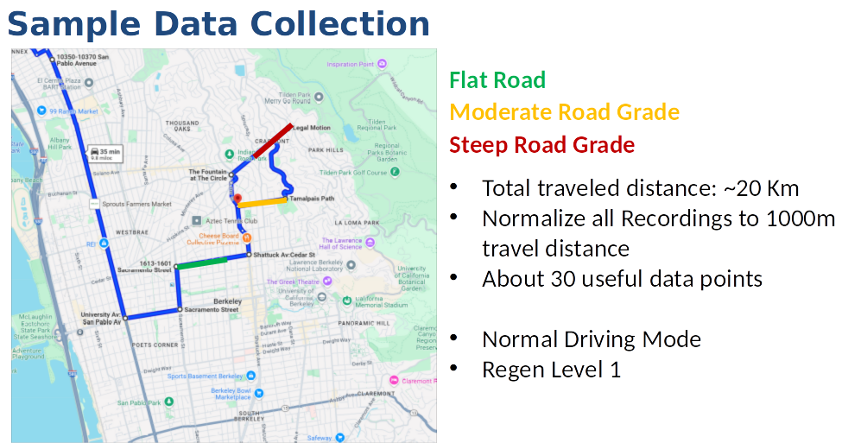
Research contents
Collected Data with full metry on a tailored drive in hilly Berkeley

Slide 8
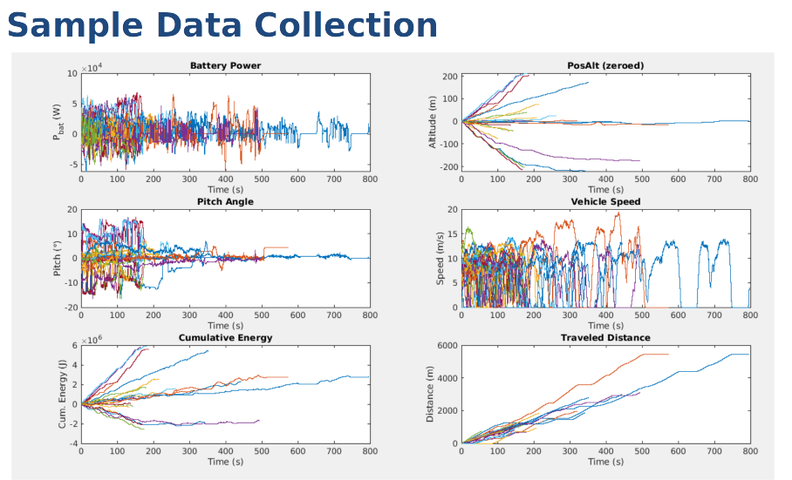
Research contents
Filter the data and normalize each valid data point to 1000m

Slide 9
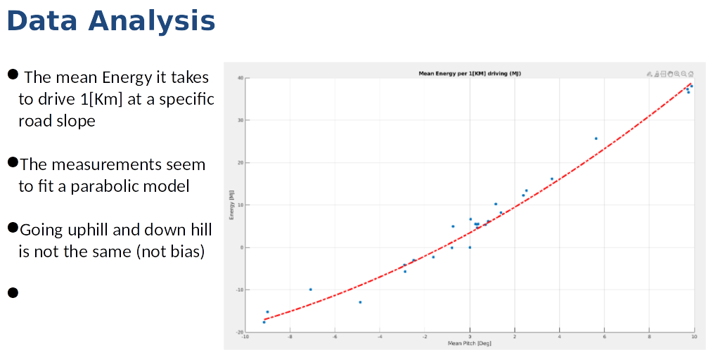
Research contents
Identify the main parameters that affect energy consumption and suggest a prediction model

Slide 10
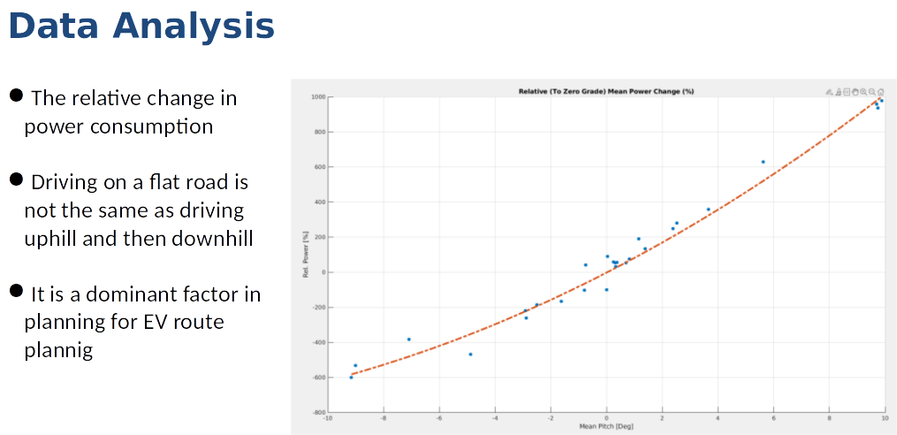
Research contents
Data analysis - The effect of sloped roads on EV energy consumption is dramatic and should be taken into account, can increase power consumption by hundreds of presents

Slide 11
Midterm research results
Research results | Characteristics/Performance | Remark
Mid-term report | Collected data on a Hyundai IONIQ 5 for many driving scenarios on different road grades Analyzed the data and suggested a model that can fit the data identify weak points of the model
Final Report
H/W
S/W | Implement a model that predicts the energy consumption based on road grade and other driving parameters Develop analysis tool to generate a model to predict energy consumption of EV on sloped roads Implement a path planner that can take into account energy consumption based on road grade
Theses |  | □ submission □ Published □ Expected date (00.00.00)
Patent |  | □ Application □ Registration □ Expected date (00.00.00)

Slide 12
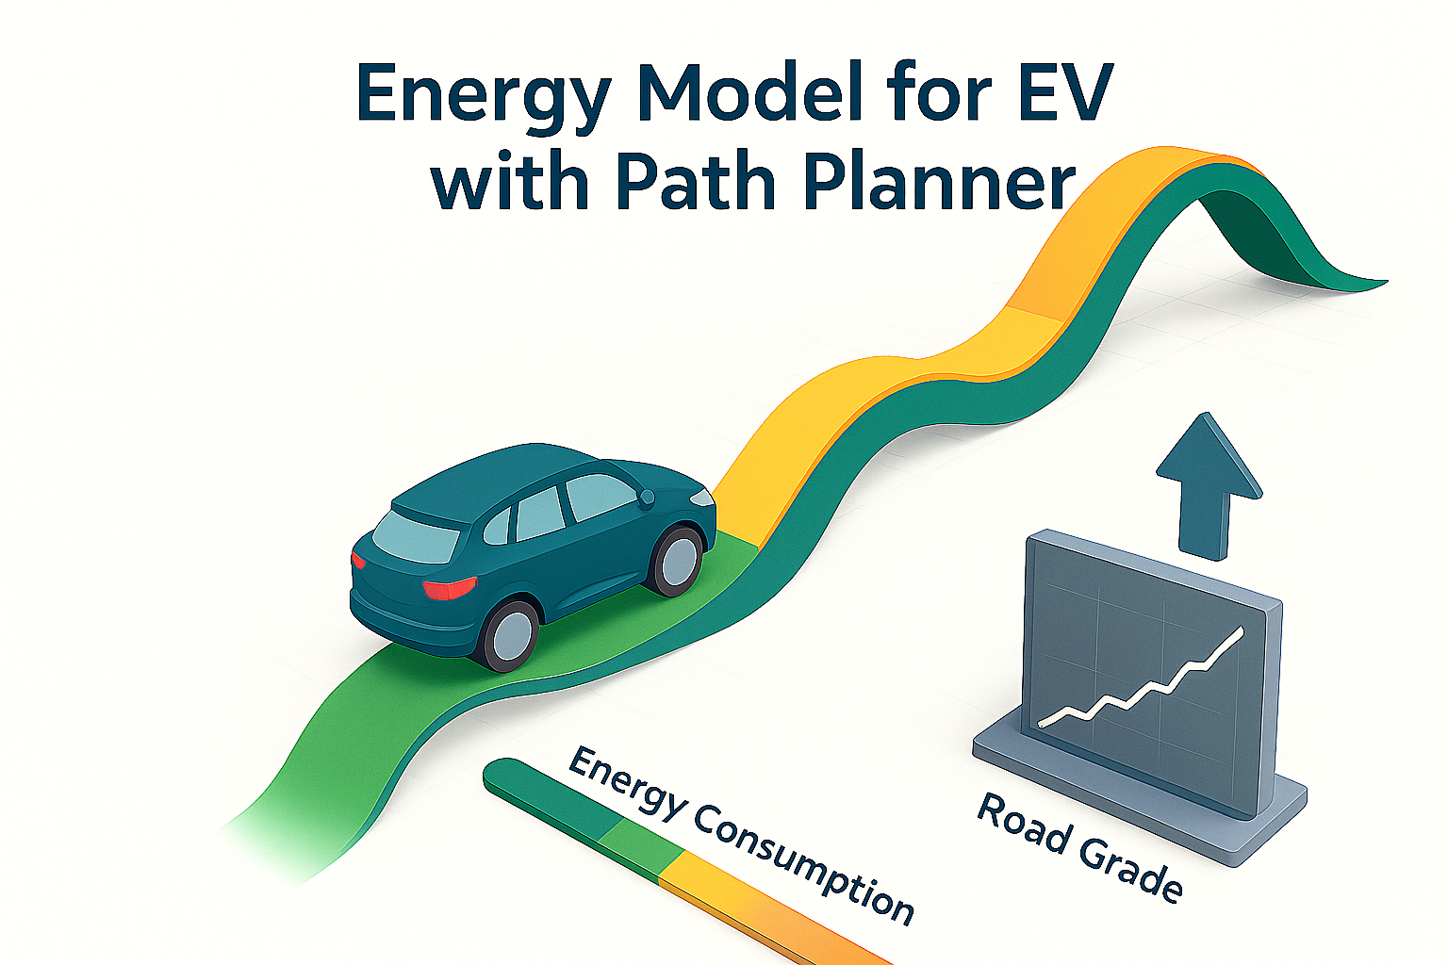
Future research plan
Next steps
Collect more data on different ReGen levels to see the effect on energy consumption
Generalize a energy consumption model not specific for a single car
Incorporate the energy model suggested in a path planner to see the effect

